Slide 1
EXPLORING CLOUD INFRASTRUCTURE
Module-3

Slide 2
EXPLORING CLOUD INFRASTRUCTURE
Barrie Sosinsky, “Cloud Computing Bible”, Wiley-India, 2010 . (Text Book 1: Chapter 11 & 12)
Reference : White paper
Administrating the Clouds ,Management responsibilities ,Lifecycle management , Cloud Management Products, Emerging Cloud Management Standards, Securing the Cloud, Securing Data , Establishing Identity and Presence
Notes:
A white paper is an in-depth report or guide about a specific topic and the problems that surround it

Slide 3
Administrating the Clouds
The explosive growth in cloud computing services has led many vendors to rename their products and reposition them to get in on the gold rush in the clouds.
What was once a network management product is now a cloud management product

Slide 4
Administrating the Clouds
Fundamental features are offered by traditional network management systems:
Administration of resources
Configuring resources
Enforcing security
Monitoring operations
Optimizing performance
Policy management
Performing maintenance
Provisioning of resources

Slide 5
Describing virtualization
Network management systems are often described in terms of the acronym FCAPS, which stands for these features:
F ault
C onfiguration
A ccounting
P erformance
S ecurity

Slide 6
Administrating the Clouds
Most network management packages have one or more of these characteristics; no single package provides all five elements of FCAPS.
To get the complete set of all five of these management areas from a single vendor, you would need to adopt a network management framework. These large network management frameworks were industry leaders several years back: BMC PATROL, CA Unicenter, IBM Tivoli, HP OpenView, and Microsoft System Center.

Slide 7
Administrating the Clouds
Network framework products have been sliced and diced in many different ways over the years, and they are rebranded from time to time. Today, for example, BMC PATROL is now part of BMC ProactiveNet Performance Management (bmc/products/product- listing/ProactiveNet-Performance-Management html), HP OpenView has been split (h10078 hp/cda/hpms/display/main/hpms content?zn=bto&cp=1-10^36657 400 0 100) into a set of HP Manager product

Slide 8
Administrating the Clouds
These five vendors have (or soon will have) products for cloud management. Computer Associates, for example, has completely repositioned its network management portfolio as an IT Management Software as a Service. Find the cloud products for these five large cloud vendors at the following URLs:
• BMC Cloud Computing (bmc/solutions/esm-initiative/cloud-computing html)
• Computer Associates Cloud Solutions (ca/us/cloud-computing.aspx)

Slide 9
Administrating the Clouds
• HP Cloud Computing (h20338 hp.com/enterprise/w1/en/technologies/cloud-computing-overview)
Managing & Securing the Cloud: Administrating the Clouds, Cloud Management Products, Emerging
Cloud Management Standards, Securing the Cloud, Securing Data, Establishing Identity and Presence.
• IBM Cloud Computing (ibm/ibm/cloud/)
• Microsoft Cloud Services (http://www microsoft/cloud/) Figure 11 shows IBM Tivoli Service Automation Manager, a framework tool for managing cloud infrastructure. FIGURE 11. Tivoli Service Automation Manager lets you create and stage cloud -based servers.
Management responsibilities

Slide 10
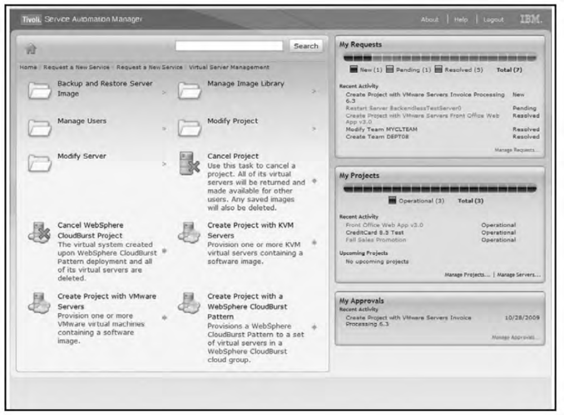
Administrating the Clouds
FIGURE 11. Tivoli Service Automation Manager lets you create and stage cloud -based servers.
Management responsibilities

Slide 11
Lifecycle management
Cloud services have a defined lifecycle, just like any other system deployment. A management program has to touch on each of the six different stages in that lifecycle:
1. The definition of the service as a template for creating instances
Tasks performed in Phase 1 include the creation, updating, and deletion of service templates.
2. Client interactions with the service, usually through an SLA (Service Level Agreement) contract This phase manages client relationships and creates and manages service contracts.

Slide 12
Lifecycle management (CONTD..)
3. The deployment of an instance to the cloud and the runtime management of instances : Tasks performed in Phase Include the creation, updating, and deletion of service offerings.
4. The definition of the attributes of the service while in operation and performance of modifications of its properties: The chief task during this management phase is to perform service optimization and customization.
5. Management of the operation of instances and routine maintenance During Phase 5, you must monitor resources, track and respond to events, and perform reporting and billing functions.
6. Retirement of the service End of life tasks include data protection and system migration, archiving, and service contract termination

Slide 13
Cloud Management Products
Cloud management software and services is a very young industry, and as such, it has a very large number of companies, some with new products and others with older products competing in this area. Table 11.1 shows some of the current players in this market, along with the products they either are offering or are promising in the very near future
Table 11.1
Product URL Description
AbiCloud http://www.abiquo.com/ Virtual machine conversion and management
Amazon CloudWatch http://aws.amazon.com/cloudwatch/ AWS dashboard
BMC Cloud Computing Initiative http://www.bmc.com/solutions/ esm-initiative/cloud-computing. html Cloud planning, lifecycle management, optimization, and guidance
CA Cloud Connected Management Suite http://www.ca.com/us/cloudsolutions.aspx CA Cloud Insight, CA Cloud Compose, CA Cloud Optimize, and CA Cloud Orchestrate are described below Cacti http://www.cacti.net/ Network performance graphing solution CloudKick https://www.cloudkick.com/ Cloud server monitoring….

Slide 14
The core management features offered by most cloud management service products include the following:
1. Support of different cloud types
2. Creation and provisioning of different types of cloud resources, such as machine instances, storage, or staged applications
3. Performance reporting including availability and uptime, response time, resource quota usage, and other characteristics
4. The creation of dashboards that can be customized for a particular client’s needs

Slide 15
Emerging Cloud Management Standards
As it stands now, different cloud service providers use different technologies for creating and managing cloud resources.
As the area matures, cloud providers are going to be under considerable pressure from large cloud users like the federal government to conform to standards and make their systems interoperable with one another.
No entity is likely to want to make a major investment in a service that is a silo or from which data is difficult to stage or to extract.
To this end, a number of large industry players such as VMware, IBM, Microsoft, Citrix, and HP have gotten together to create standards that can be used to promote cloud interoperability.
In the section that follows, you learn about the work of the DMTF in this area

Slide 16
DMTF cloud management standard
The Distributed Management Task Force (DMTF; see http://www.dmtf.org/) is an industry
organization that develops industry system management standards for platform interoperability.
Its membership is a “who’s who” in computing, and since its founding in 1992, the group has been responsible for several industry standards, most notably the Common Information Model (CIM).
The DMTF organizes itself into a set of working groups that are tasked with specifying standards for different areas of technology

Slide 17
DMTF cloud management standard
A recent standard called the Virtualization Management Initiative (VMAN) was developed to extend CIM to virtual computer system management.
VMAN has resulted in the creation of the Open Virtualization Format (OVF), which describes a standard method for creating, packaging, and provisioning virtual appliances.
OVF is essentially a container and a file format that is open and both hypervisor- and processor-architecture-agnostic.
Since OVF was announced in 2009, vendors such as VirtualBox, AbiCloud, IBM, Red Hat, and VMWare have announced or introduced products that use OVF

Slide 18
Understanding Cloud Security
Security in cloud computing is a major concern.
Data in cloud should be stored in encrypted form.
To restrict client from accessing the shared data directly, proxy and brokerage services should be employed.
Logging, auditing, and regulatory compliance are all features that require
planning in cloud computing system
Notes:
Audit logs are essential for ensuring the security of an organization's information systems. They track all events that occur within a system, including log-on attempts, file access, network connection, and other crucial operations.

Slide 19
Understanding Cloud Security
Before deploying a particular resource to cloud, one should need to analyze several aspects of the resource such as:
Select resource that needs to move to the cloud and analyze its sensitivity to risk.
Consider cloud service models such as IaaS, PaaS, and SaaS. These models require customer to be responsible for security at different levels of service.
Consider the cloud type to be used such as public, private, community or hybrid.
Understand the cloud service provider's system about data storage and its transfer into and out of the cloud.

Slide 20
Security Boundaries
A particular service model defines the boundary between the responsibilities of service provider and customer.
The most commonly used model based on U.S. National Institute of Standards and Technology (NIST; separates deployment models from service models and assigns those models a set of service attributes. Deployment models are cloud types: community, hybrid, private, and public clouds. Service models follow the SPI Model for three forms of service delivery: Software, Platform, and Infrastructure as a Service
Cloud Security Alliance (CSA) stack model defines the boundaries between each service model and shows how different functional units relate to each other. :
Notes:
In the NIST model, as you may recall, it was not required that a cloud use virtualization to pool resources, nor did that model require that a cloud support multi-tenancy. It is just these factors that make security such a complicated proposition in cloud computing

Slide 21
Security Boundaries
One key difference between the NIST model and the CSA is that the CSA considers multi-tenancy to be an essential element in cloud computing.
Multi-tenancy adds a number of additional security concerns to cloud computing that need to be accounted for.
In multi-tenancy, different customers must be isolated, their data segmented, and their service accounted for.
To provide these features, the cloud service provider must provide a policy-based environment that is capable of supporting different levels and quality of service, usually using different pricing models.
Multi-tenancy expresses itself in different ways in the different cloud deployment models and imposes security concerns in different places
The following diagram shows the CSA stack model:
Notes:
In the NIST model, as you may recall, it was not required that a cloud use virtualization to pool resources, nor did that model require that a cloud support multi-tenancy. It is just these factors that make security such a complicated proposition in cloud computing

Slide 22
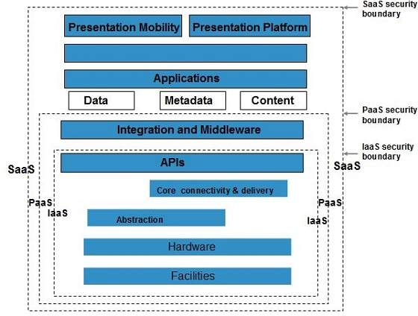
Security Boundaries
The following diagram shows the CSA stack model:
Notes:
In the SaaS model, the vendor provides security as part of the Service Level Agreement, with the compliance, governance, and liability levels stipulated under the contract for the entire stack. For the PaaS model, the security boundary may be defined for the vendor to include the software framework and middleware layer. In the PaaS model, the customer would be responsible for the security of the application and UI at the top of the stack. The model with the least built-in security is IaaS, where everything that involves software of any kind is the customer’s problem

Slide 23
Key Points to CSA Model
IaaS is the most basic level of service with PaaS and SaaS next two above levels of services.
Moving upwards, each of the service inherits capabilities and security concerns of the model beneath.
IaaS provides the infrastructure, PaaS provides platform development environment, and SaaS provides operating environment.
IaaS has the least level of integrated functionalities and integrated security while SaaS has the most.
This model describes the security boundaries at which cloud service provider's responsibilities end and the customer's responsibilities begin.
Any security mechanism below the security boundary must be built into the system and should be maintained by the customer.

Slide 24
Understanding Data Security
Since all the data is transferred using Internet, data security is of major concern in the cloud.
Here are key mechanisms for protecting data:
Access Control
Auditing
Authentication
Authorization
Notes:
Authorization is the number of functions the user can perform or information the user has access to. It is where the access control system comes into play and serves its main purpose
Network security auditing is the process of independently examining information relating to your organization's IT controls, security systems, and risk mitigation policies and procedures.
1.The process of verifying the identity of a user, process, or device, often as a prerequisite to allowing access to resources in an information system.
An IT security audit is an assessment of an information system's security architecture and processes, as well as all related policies and procedures for managing data in a secure manner.
A cloud audit is a test of a cloud environment, typically conducted by an independent third-party. During an audit, the auditor gathers evidence via physical inspection, inquiry, observation, re-performance, or analytics.
4. Authorization is the number of functions the user can perform or information the user has access to. It is where the access control system comes into play and serves its main purpose.
Access control is a data security process that enables organizations to manage who is authorized to access corporate data and resources. Secure access control uses policies that verify users are who they claim to be and ensures appropriate control access levels are granted to users.
3. Data access control is a technique used to regulate employees access to files in an organization. Access Control in cloud security is a system with which a company can regulate and monitor permissions, or access to their business data by formulating various policies suited chosen by the company.
4. Authorization in system security is the process of giving the user permission to access a specific resource or function.

Slide 25
Brokered Cloud Storage Access is an approach for isolating storage in the cloud:
In this approach, two services are created:
A broker with full access to storage but no access to client.
A proxy with no access to storage but access to both client and broker.

Slide 26
Working Of Brokered Cloud Storage Access System
When the client issues request to access data
The client data request goes to the external service interface of proxy.
The proxy forwards the request to the broker.
The broker requests the data from cloud storage system.
The cloud storage system returns the data to the broker.
The broker returns the data to proxy.
Finally the proxy sends the data to the client.

Slide 27
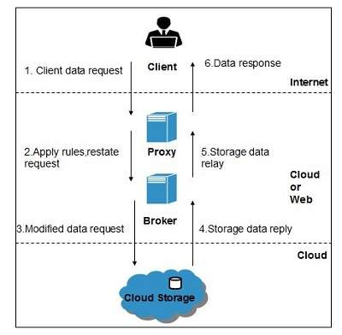
Working Of Brokered Cloud Storage Access System
All of the above steps are shown in the following diagram:
Figure 12.4
Notes:
A cloud proxy is a cloud-based system that sits between a client and a web server, SaaS application, or data center. It acts as an intermediary between the client and the server, providing secure access to resources while protecting the server from malware and other threats.
A cloud access security broker (CASB) is an on-premises or cloud-based security policy enforcement point between cloud service consumers and providers.

Slide 28
Working Of Brokered Cloud Storage Access System
The use of multiple encryption keys can further separate the proxy service from the storage account.
If you use two separate keys to create two different data zones—one for the untrusted communication between the proxy and broker services, and another a trusted zone between the broker and the cloud storage—you create a situation where there is further separation between the different service roles
Even if the proxy service is compromised, that service does not have access to the trusted key necessary to access the cloud storage account..

Slide 29
Encryption
Most cloud service providers store data in an encrypted form. While encryption is important and effective, it does present its own set of problems.
When there is a problem with encrypted data, the result is that the data may not be recoverable.
It is worth considering what type of encryption the cloud provider uses and to check that the system has been planned and tested by security experts

Slide 30
Encryption
Most cloud service providers store data in an encrypted form. While encryption is important and effective, it does present its own set of problems.
When there is a problem with encrypted data, the result is that the data may not be recoverable. It is worth considering what type of encryption the cloud provider uses and to check that the system has been planned and tested by security experts

Slide 31
Encryption
Strong encryption technology is a core technology for protecting data in transit to and from the cloud as well as data stored in the cloud
The goal of encrypted cloud storage is to create a virtual private storage system that maintains confidentiality and data integrity while maintaining the benefits of cloud storage: ubiquitous, reliable, shared data storage.
Encryption should separate stored data (data at rest) from data in transit

Slide 32
Encryption
Encryption should separate stored data (data at rest) from data in transit
Depending upon the particular cloud provider, you can create multiple accounts with different keys as you saw in the example with Windows Azure Platform in the previous section.
Microsoft allows up to five security accounts per client, and you can use these different accounts to create different zones.
On Amazon Web Service, you can create multiple keys and rotate those keys during different sessions.

Slide 33
Encryption
Strong encryption technology is a core technology for protecting data in transit to and from the cloud as well as data stored in the cloud
The goal of encrypted cloud storage is to create a virtual private storage system that maintains confidentiality and data integrity while maintaining the benefits of cloud storage: ubiquitous, reliable, shared data storage.
Encryption should separate stored data (data at rest) from data in transit
Depending upon the particular cloud provider, you can create multiple accounts with different keys as you saw in the example with Windows Azure Platform in the previous section.
Microsoft allows up to five security accounts per client, and you can use these different accounts to create different zones.
On Amazon Web Service, you can create multiple keys and rotate those keys during different sessions.

Slide 34
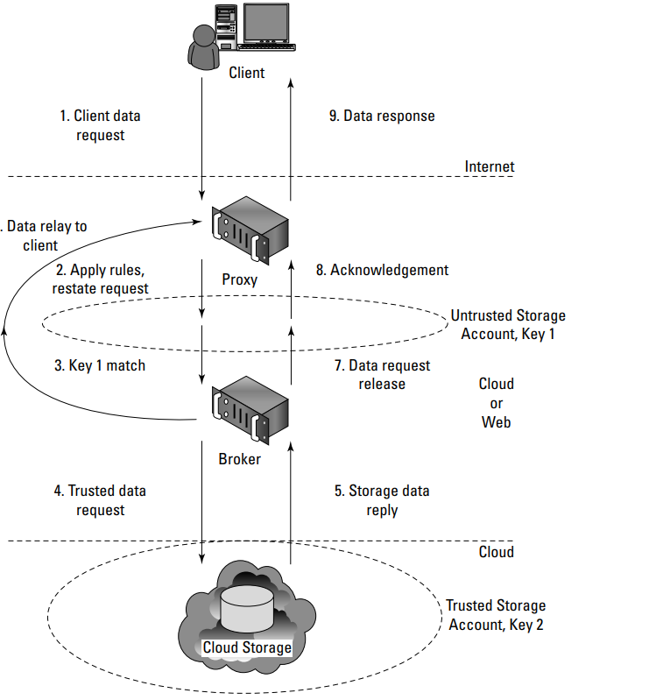
Encryption
The creation of storage zones with associated encryption keys can further protect cloud storage from unauthorized access
Figure 12.5

Slide 35
Encryption
In the multi-key solution, shown in Figure 12.5, you have not only eliminated all internal service endpoints, but you also have eliminated the need to have the proxy service run at a reduced trust level

Slide 36
Auditing and Compliance
Logging is the recording of events into a repository;
Auditing is the ability to monitor the events to understand performance.
Logging and auditing is an important function because it is not only necessary for evaluation performance, but it is also used to investigate security and when illegal activity has been perpetrated.
Logs should record system, application, and security events, at the very minimum.
Logging and auditing are unfortunately one of the weaker aspects of early cloud computing service offerings

Slide 37
Auditing and Compliance
Cloud service providers often have proprietary log formats that you need to be aware of.
Whatever monitoring and analysis tools you use need to be aware of these logs and able to work with them.
Often, providers offer monitoring tools of their own, many in the form of a dashboard with the potential to customize the information you see through either the interface or programmatically using the vendor’s API.

Slide 38
Auditing and Compliance
Because cloud services are both multitenant and multisite operations, the logging activity and data for different clients may not only be co-located, they may also be moving across a landscape of different hosts and sites.
You can’t simply expect that an investigation will be provided with the necessary information at the time of discovery unless it is part of your Service Level Agreement.
Even an SLA with the appropriate obligations contained in it may not be enough to guarantee you will get the information you need when the time comes.
It is wise to determine whether the cloud service provider has been able to successfully support investigations in the past

Slide 39
Auditing and Compliance
As it stands now, nearly all regulations were written without keeping cloud computing in mind.
A regulator or auditor isn’t likely to be familiar with the nature of running applications and storing data in the cloud.
Even so, laws are written to ensure compliance, and the client is held responsible for compliance under the laws of the governing bodies that apply to the location where the processing or storage takes place

Slide 40
Auditing and Compliance
understand the following:
Which regulations apply to your use of a particular cloud computing service
Which regulations apply to the cloud service provider and where the demarcation line falls for responsibilities
How your cloud service provider will support your need for information associated with regulation
How to work with the regulator to provide the information necessary regardless of who had the responsibility to collect the data
Notes:
Compliance:
the act of obeying a law or rule, especially one that controls a particular industry or type of work

Slide 41
Auditing and Compliance
In the case of a cloud service provider who shows reluctance to or limits the scrutiny of its operations, it is probably wise to use the service in ways that limit your exposure to risk.
For example, although encrypting stored data is always a good policy, you also might want to consider not storing any sensitive information on that provider’s system.

Slide 42
Auditing and Compliance
As it stands now, clients must guarantee their own regulatory compliance, even when their data is in the care of the service provider.
You must ensure that your data is secure and that its integrity has not been compromised.
When multiple regulatory entities are involved, as there surely are
between site locations and different countries, then that burden to satisfy the laws of those governments is also your responsibility.

Slide 43
Establishing Identity
What is an identity?
What are the standard ways to establish an identity?
Notes:
Is set of ch/cs that make something recognizable or known
Person identity: things u are(age,gender) things you know(biography, security no, pin), you have(finger print, blood vessel in eye)
In computer network system, it is ones digital identity (is in terms of attributes or metadata of an object)
OpenID is the developing industry standard for authenticating end users by using strong digital identity in a common format (for example one factor:username, pwd+ 2 factor (key) 3 factor biometric
The main difference between OAuth2 and OpenID Connect is that OAuth2 is only concerned with authorization, while OpenID Connect is also concerned with authentication
Authorization: XACML, SAML
Single sign-on (SSO) is an identification method that enables users to log in to multiple applications and websites with one set of credentials. SSO streamlines the authentication process for users.

Slide 44
Establishing Identity
Federated identity management is an arrangement that can be made among multiple enterprises that lets subscribers use the same identification data to obtain access to services of all enterprises in the group
Within the enterprise, an identity management system comprises a system of directories and access control based on policies.
It includes the maintenance of the system (adds, changes, deletes) and generally offers authentication, authorization, SSO and auditing.
When federating identities to the cloud, organizations may need to manage the identity life cycle using their IAM system and processes
Notes:
Identity and access management
Single sign-on (SSO) is an identification method that enables users to log in to multiple applications and websites with one set of credentials. SSO streamlines the authentication process for users.
Identity lifecycle management (ILM) is the full life cycle of identity and access for any user in the network. It covers every aspect of identity and access management (IAM) from the moment a person is on-boarded to the moment they leave the company.
Federated identity allows authorized users to access multiple applications and domains using a single set of credentials.

Slide 45
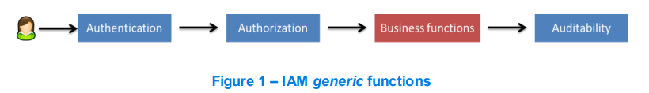
IAM system
Identity Management is the combination of business process and technology used to manage data on IT systems and applications about users.
Managed data includes user objects, identity attributes, security entitlements and authentication factors
Figure 1 shows, at blue, the three main functionalities of an IAM system.
Notes:
The user is authenticated and authorized to access business functions (i.e. services). All the related operations feed the auditing system that may be used to fraud detection or to guarantee that security constraints, standards (i.e. ISO 27000 series), or laws (i.e. Sarbanes Oxley [16]) are been taken into consider ation within the enterprise

Slide 46
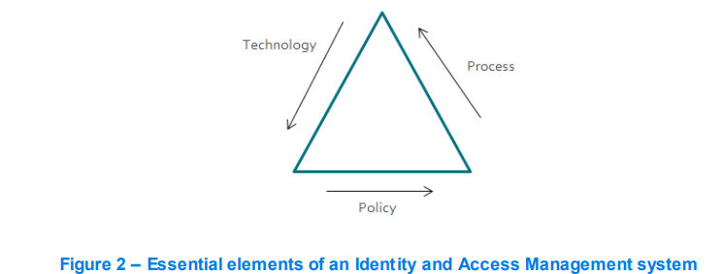
IAM system
IAM is not just about technology, it comprises three essential elements: policies, processes and technologies.
Notes:
Policies refer to the constraints and standards that needs to be followed in order to comply with regulations and business best practices; processes describe the sequences of steps that lead to the completion of business tasks or functions; technologies are the tools that help accomplish business goals more efficiently and accurately while meeting the constraints and guidelines specified in the policies. This relation is essential to understand the IAM ecosystem is to clearly apply such systems to enterprises

Slide 47
Standardization and Initiative Groups
The Identity Management area, and all the related domains, has been the ground for several initiatives.
Some of the initiatives are drive by more traditional organization groups such as
OAuth protocol
OASIS (Organization for the Advancement of Structured Information Standards) promotes industry consensus and produces worldwide standards for security, Cloud computing, SOA, Web services, the Smart Grid,
Notes:
OAuth is an open-standard authorization protocol or framework that provides applications the ability for “secure designated access.” For example, you can tell Facebook that it's OK for ESPN.com(internationa; sports channel) to access your profile or post updates to your timeline without having to give ESPN your Facebook password.

Slide 48
Standardization and Initiative Groups
OAuth 2.0
OAuth 2.0 logoOAuth 2.0 is the industry-standard protocol for authorization.
OAuth 2.0 focuses on client developer simplicity while providing specific authorization flows for web applications, desktop applications, mobile phones, and living room devices.
This specification and its extensions are being developed within the IETF OAuth Working Group.
Notes:
IETF: Internet Engineering Task Force: The IETF is working on standards for automated network management which, as the name implies, aims to improve and make more efficient management of networks

Slide 49
Standardization and Initiative Groups
OASIS (Organization for the Advancement of Structured Information Standards) promotes industry consensus and produces worldwide standards for security, Cloud computing, SOA, etc
OASIS open standards offer the potential to lower cost, stimulate innovation, grow global markets, and protect the right of free choice of technology.
OASIS defines a set of standards related with Identity Management topics.
Among them are the following one:
SAML (Secure Assertion Markup Language) protocol and bindings
XACML (eXtensible Access Control Markup Language)

Slide 50
SAML
Security Assertion Markup Language (SAML) [6] is an XML standard that allows secure web domains to exchange user authentication and authorization data.
Using SAML, an online service provider can contact a separate online identity provider to authenticate users who are trying to access secure content.
Notes:
SAML transactions use Extensible Markup Language (XML) for standardized communications between the identity provider and service providers. SAML is the link between the authentication of a user's identity and the authorization to use a service.

Slide 51
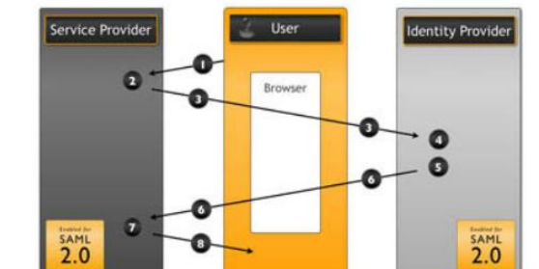
SAML
A brief overview of the SAML process is presented next and illustrated in Figure 3.
Figure 3 – SAML process

Slide 52
User requests a service from the Service Provider;
Service Provider verifies if the user has a SAML token;
User gets redirected to the Identity Provider (authentication delegation) ;
Identity Provider authenticates the user;
Identity Provider creates a SAML token;
User gets redirected to the Service Provider, with the SAML token;
Service Provider verifies the SAML token;
Service Provider gives the requested information to the user.
Notes:
Single Sign-On (SSO) is a protocol used to authenticate and authorize users to multiple applications using a single set of credentials. SSO is very convenient for users because they don't need to memorize multiple passwords and don't need to perform multiple login operations.

Slide 53
OpenID
OpenID Connect Clients use the scope values as defined in OAuth 2.0 to specify what access privileges are requested for Access Tokens.

Slide 54
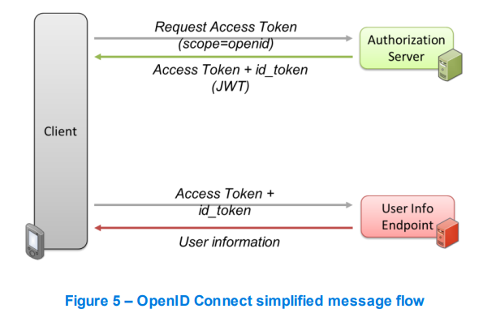
OpenID
The simplest deployment of OpenID Connect allows for clients of all types including browser-based, mobile, and javascript clients, to request and receive information about identities and currently authenticated sessions
The OpenID flow, for authorization, consists of the following steps (first set of interactions shown in Figure 5):
Notes:
Permission+identity info(token)

Slide 55
OpenID
1. Client prepares an Authorization Request containing the desired request parameters (including the scope value);
2. Client sends a request to the Authorization Server;
3. Authorization Server authenticates the End-User;
4. Authorization Server obtains the End-User Consent/Authorization;
5. Authorization Server sends the End-User back to the Client with code;
6. Client sends the code to the Token Endpoint to receive an Access Token and ID Token in the response.
Notes:
Access token: permission to consume API, ID token: identity information

Slide 56
XACML
XACML is an OASIS-ratified, general-purpose, XML-based access control language for policy management and access decisions.
It provides an XML schema for a general policy language which is used to protect any kind of resource and make access decisions over these resources.
The XACML standard not only gives the model of the policy language, but also proposes a processing environment model to manage the policies and to conclude the access decision

Slide 57
XACML
Most applications (web or otherwise) have a built-in authorization module that grants or denies access to certain application functions or resources based on entitlements assigned to the user.
Hence, the goal of XACML is to provide a standardized language, a method of access control, and policy enforcement across all applications that implement a common authorization standard.
These authorization decisions are based on various authorization policies and rules centered on the user role and job function.

Slide 58
XACML
The XACML context also specifies the request/response protocol that the application environment can use to communicate with the decision point.
The response to an access request is also specified using XML
Figure 5-5 illustrates the interaction among various health care participants with unique roles (authorization privileges) accessing sensitive patient records stored in a health care application.
Notes:
The main method for exchanging information between an authentication and authorization service in a Service Oriented Architecture is the Security Assertion Markup Language (SAML). In SAML, a service provider passes a statement or set of statements (called assertions) to an identity provider that must be evaluated

Slide 59
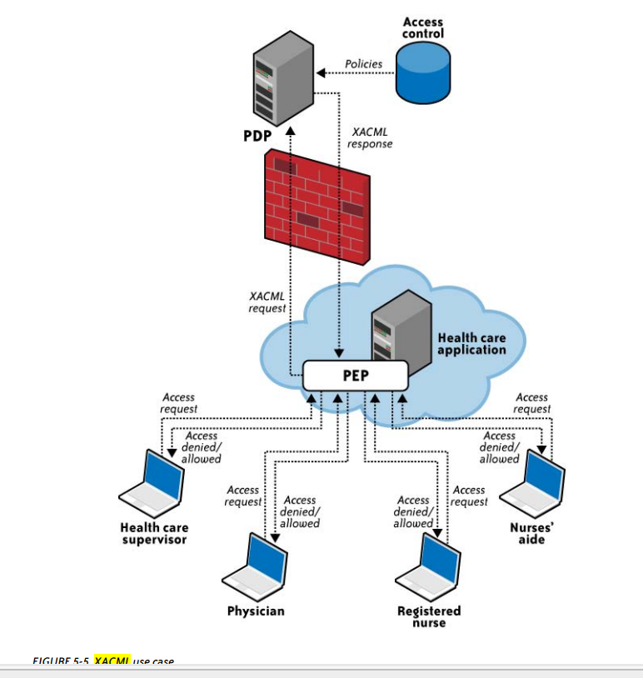
XACML
Notes:
The health care application manages various hospital associates (the physician, registered nurse, nurses’ aide, and health care supervisor) accessing various elements of the patient record. This application relies on the policy enforcement point (PEP) and forwards the request to the PEP.
The PEP is actually the interface of the application environment. It receives the access requests and evaluates them with the help of the policy decision point (PDP). It then permits or denies access to the resource (the health care record).
The PDP should be located in a trusted network with strong access control policies, e.g., in a corporate trusted network protected by a corporate firewall. 4. After evaluation, the PDP sends the XACML response to the PEP.

Slide 60
Authorization
Authorization is the process of giving someone permission to do.
Different authorization models and, at least, two granularity models are available in literature, when deal with authorization.
1. Access control lists
Access Control Lists (ACL): once a user is authenticated, the user is allowed to access an application or not depending on whether that user’s id is on a list of authorized users (white list) or blocked users (black list).
This mode is either all-in or all-out.

Slide 61
Authorization
2 Role-based access control
In the Role-based Access Control (RBAC), it is not who you are but rather what role(s) you embody.
For instance, a person might be allowed to open a door. That right (or permission) is granted because that person has the role employee, not because of who they are.
Typically, in RBAC, a user can have multiple roles to which different permissions can be granted
Notes:
But roles have their limits too. How do you express other conditions or parameters? What if you want to express a permission of the following form: “only employees can open the door between 9AM and 5PM”. With RBAC, you can express employee open door role. But it is not possible (or difficult) to really express the time constraint. I

Slide 62
Authorization
3 Attribute-based access control
Instead of defining permissions based on roles only, one should be able to use attributes.
This is Attribute Based Access Control (ABAC).
Attributes are any bit of data, or label that describes a user, resource, target, object, environment, or action.
Notes:
Anything from an apple, its color, and weight to a person eating that apple, the location of the apple… With ABAC, you can mix and match attributes to define extremely targeted (fine-grained) rules e.g. employees can open the door between 9AM and 10AM or close the door after 5PM if and only if the employee belongs to the “door opener” group

Slide 63
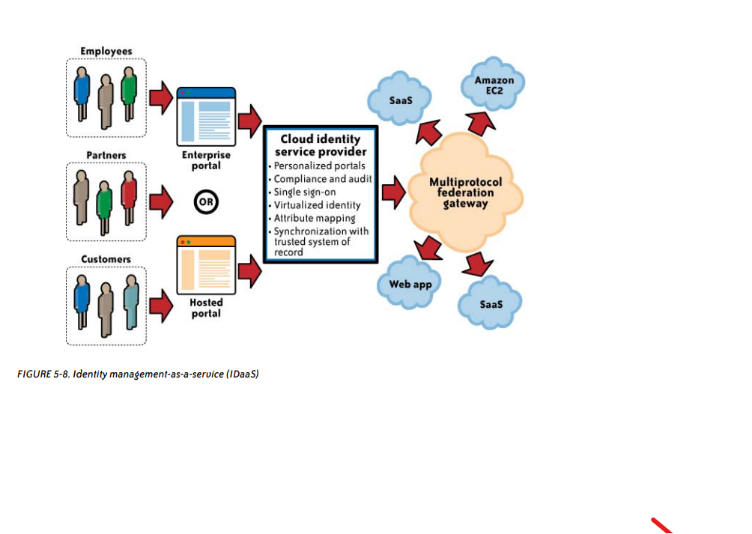
Cloud Authorization Management

